Slide 1
16x16 SRAM MEMORY ARRAY DESIGN
BY
Venkata Saket Ram(EE19B043)
M.Suchithra(EE19B047)
Surya Pratap(EE19B049)

Slide 2
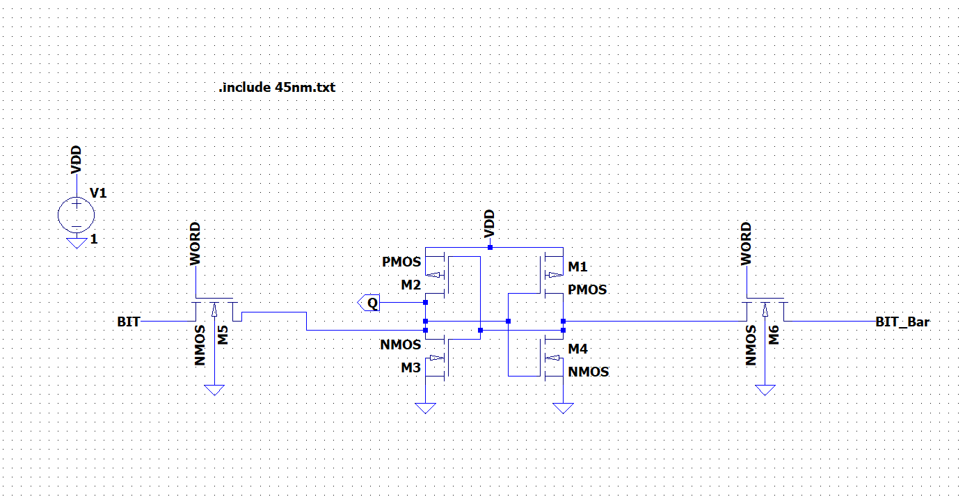
6T SRAM CELL:
Schematic:
Designed 6T SRAM
Cell in LTSPICE using
45nm pmos and nmos
technology.
In this design
PDN>Access>PUN.
Beta ratio:2
Gamma ratio:0.66

Slide 3
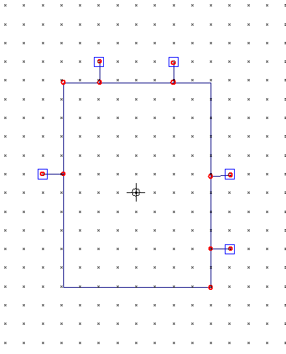
Symbol for 6T SRAM CELL:
WL
BL
BLB
Q

Slide 4
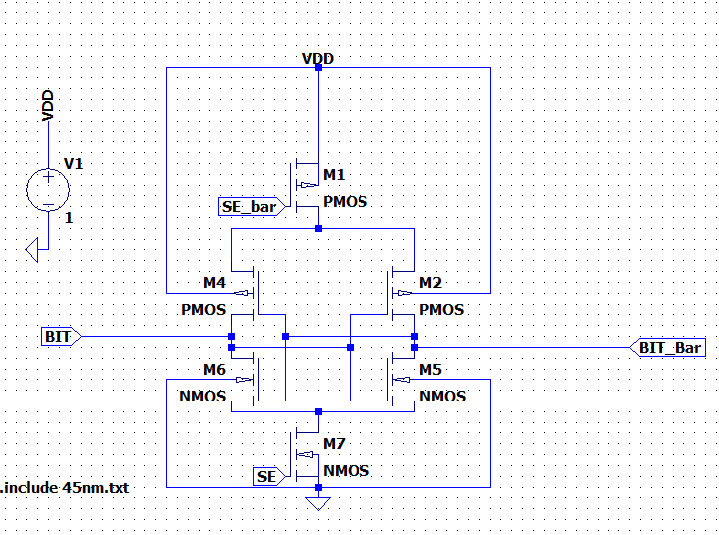
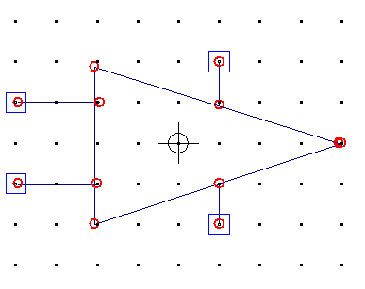
SENSE AMPLIFIER:
Schematic
Symbol
BIT BAR
SE BAR
SE
BIT
Above schematic is latch based sense amplifier,because it consumes low power and it has no static power dissipation we have used this in our design.

Slide 5
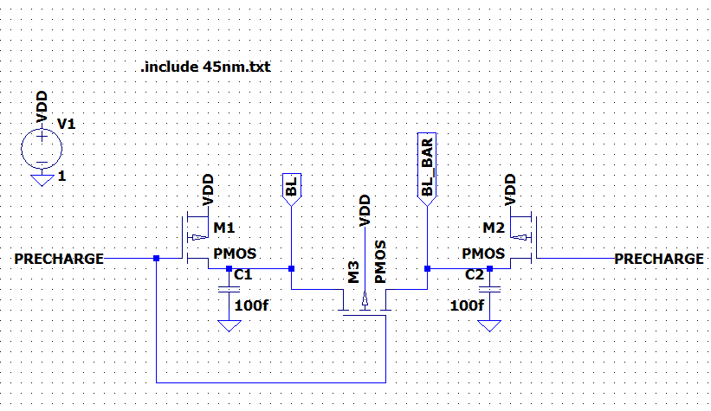
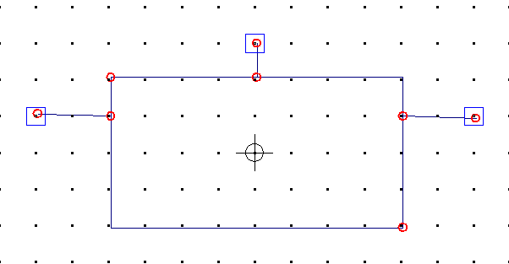
PRECHARGER
PRECHARGE
BL
BL BAR
It will precharge both bit line and bit line bar to VDD,after which once word signal is high we can perform read operation using sense amplifier

Slide 6
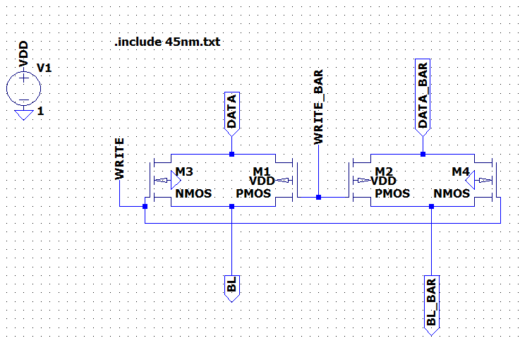
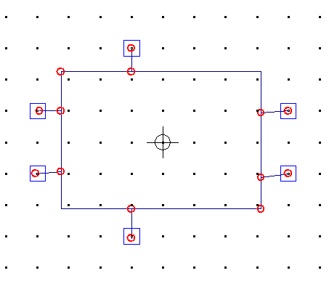
WRITE DRIVER CIRCUIT:
Schematic
Symbol
DATA
WRE
DATA BAR
BL
BL BAR
The above schematic is write driver circuit whenever write signal is high data and data bar will be connected to bitline and bitline bar and then write operation can be performed on sram cell.

Slide 7
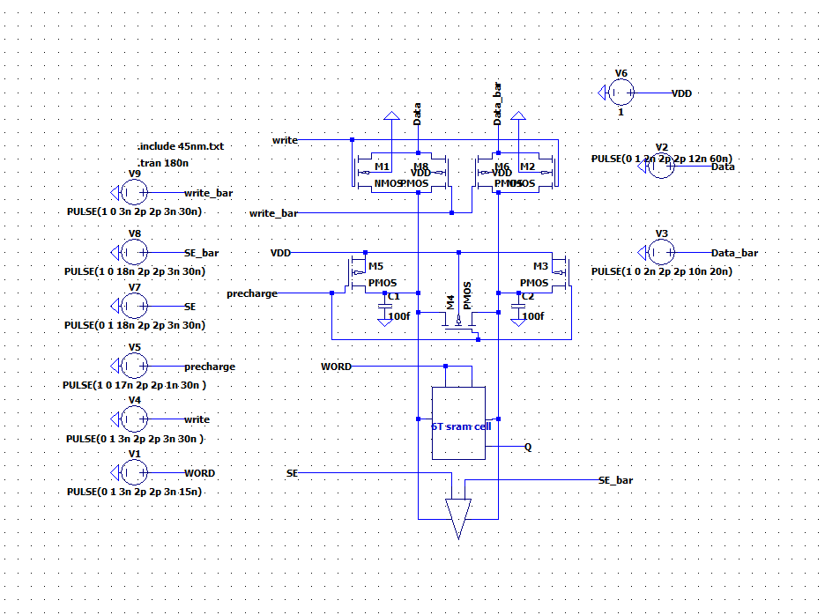
6T SRAM CELL

Slide 8
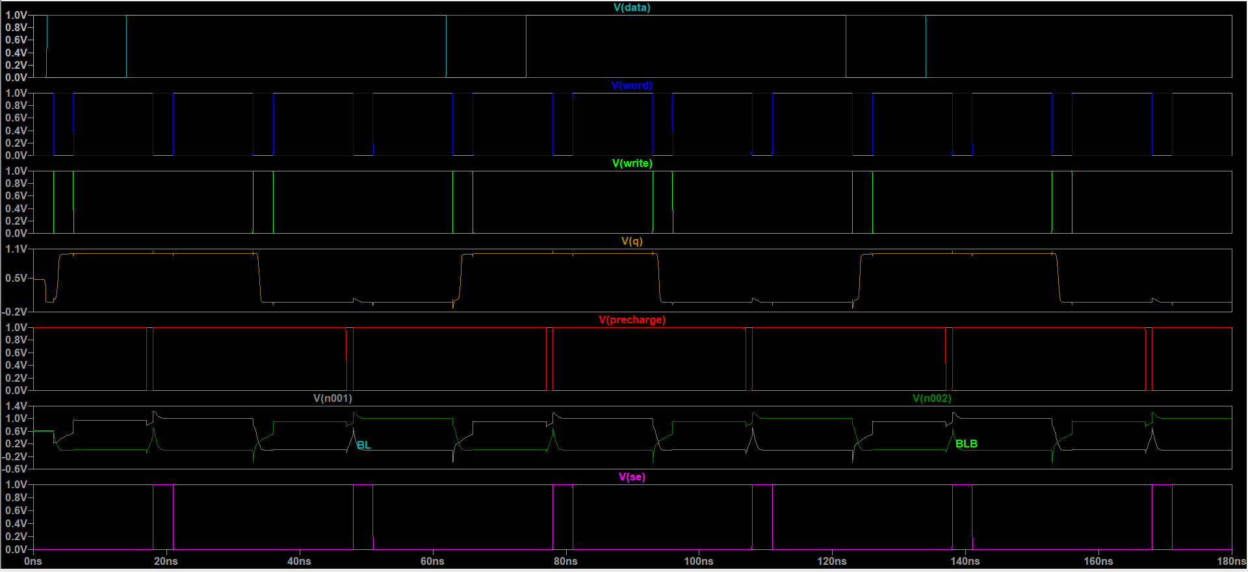
Simulation for 6T SRAM Cell

Slide 9
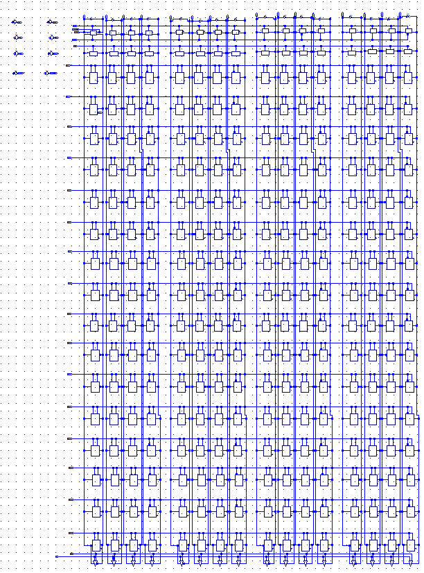
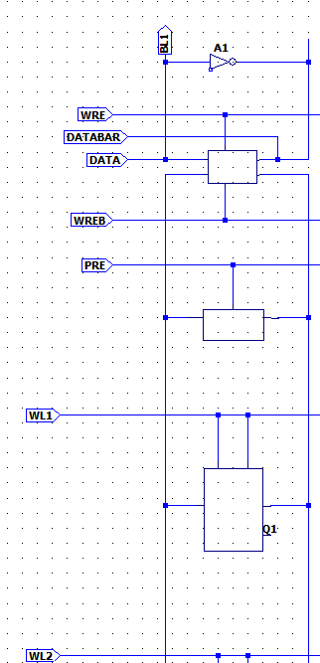
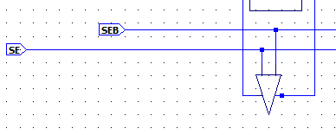
16x16 SRAM MEMORY ARRAY
WRITE DRIVER CIRCUIT
PRE CHARGE CIRCUIT
6T SRAM CELL
SENSE AMPLIFIER

Slide 10
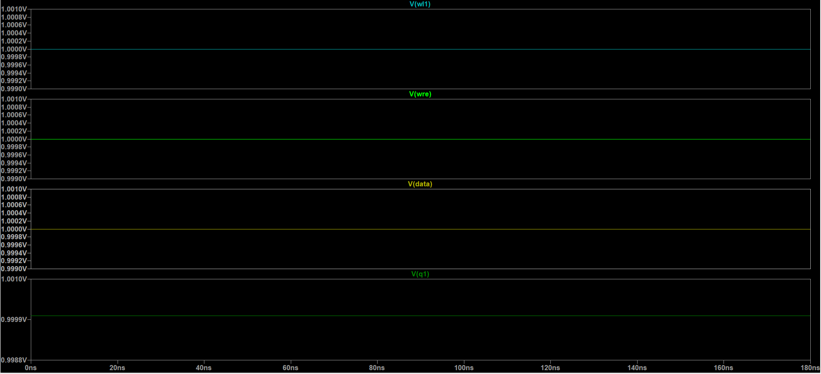
Write operation in Q1 cell

Slide 11
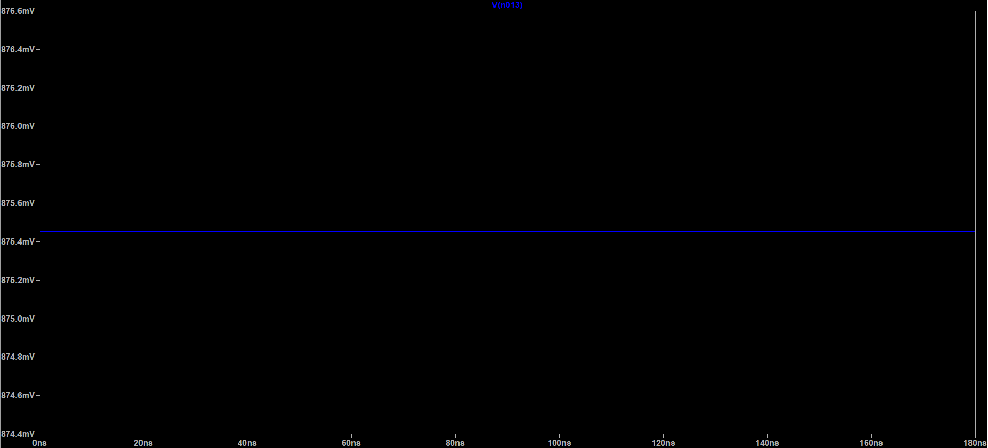
Read operation in Q1 cell:
V(BL)

Slide 12
Thank you
References:
C. S. Hemanth Kumar and B. S. Kariyappa, "Design and Power Analysis of 16×16 SRAM Array Employing 7T I-LSVL," 2018 3rd IEEE International Conference on Recent Trends in Electronics, Information & Communication Technology (RTEICT), 2018, pp. 319-322, doi: 10.1109/RTEICT42901.2018.9012414.
https://www.youtube.com/watch?v=lPnQVrzgC-M&t=1126s

